Slide 1
Week 3-4
Topic: Defining the research problem
Dr. Waqar Mehmood
Professor
RSCI
RIU

Slide 2
The Research Process
Research process consists of series of actions or steps necessary to effectively carry out research and the desired sequencing of these steps.
The chart shown in Figure 1.1 well illustrates a research process.

Slide 3
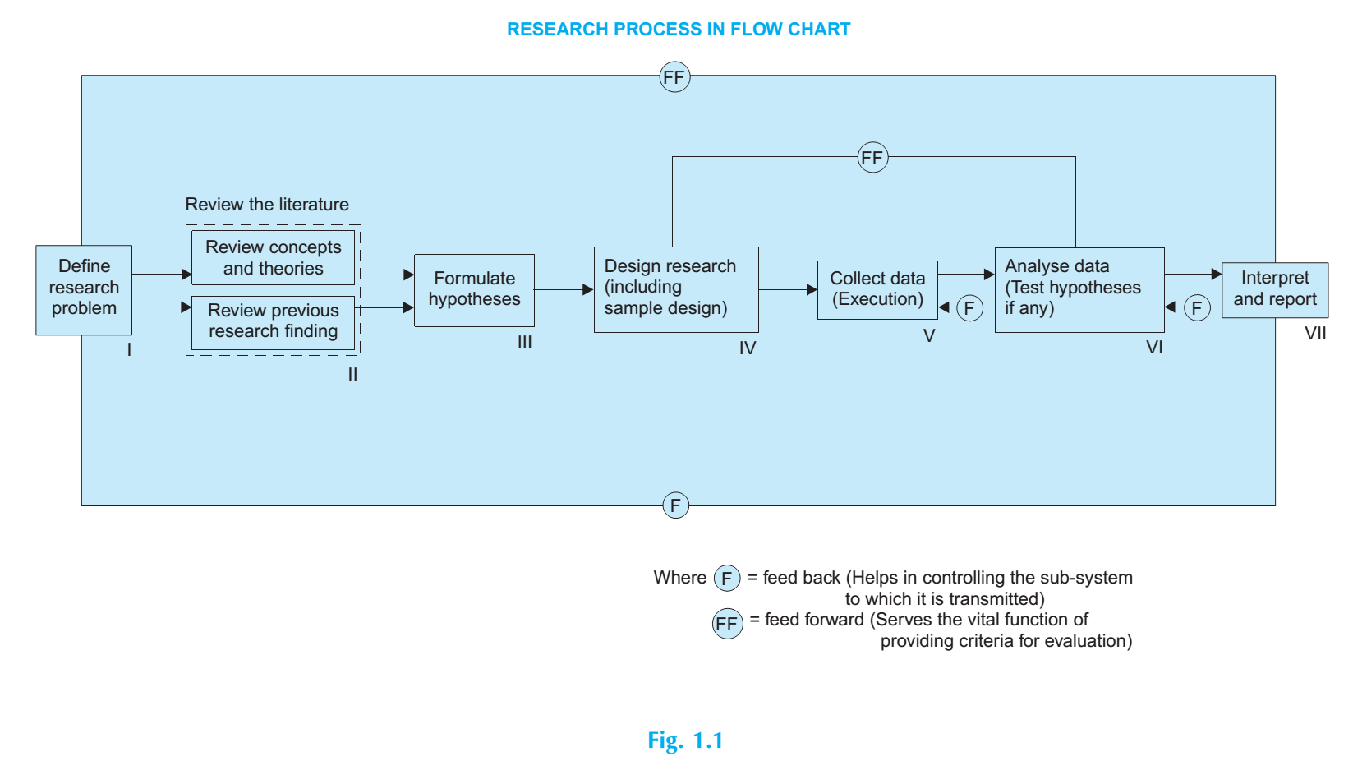

Slide 4
The Research Process
Research activities overlap continuously rather than following a strictly prescribed sequence. At times, the first step determines the nature of the last step to be undertaken.
One should remember that the various steps involved in a research process are not mutually exclusive; nor they are separate and distinct.
They do not necessarily follow each other in any specific order and the researcher has to be constantly anticipating at each step in the research process the requirements of the subsequent steps.

Slide 5
The Research Process
Typical stages include:
Identify research problem
Literature review
Formulate research questions/hypotheses
Select research design & methodology
Collect data
Analyze data
Interpret results
Report & disseminate findings

Slide 6
1. Formulating the research problem:
In research process, the first and foremost step happens to be that of selecting and properly defining a research problem.
A researcher must find the problem and formulate it so that it becomes susceptible to research.
Like a medical doctor, a researcher must examine all the symptoms (presented to him or observed by him) concerning a problem before he can diagnose correctly.
To define a problem correctly, a researcher must know: what a problem is?

Slide 7
1. Formulating the research problem:
At the very outset the researcher must single out the problem he wants to study, i.e., he must decide the general area of interest or aspect of a subject-matter that he would like to inquire into.
Initially the problem may be stated in a broad general .
The formulation of a general topic into a specific research problem, thus, constitutes the first step in a scientific enquiry.
Essentially two steps are involved in formulating the research problem, viz., understanding the problem thoroughly, and rephrasing the same into meaningful terms from an analytical point of view.

Slide 8
1. Formulating the research problem:
The best way of understanding the problem is to discuss it with one’s own colleagues or with those having some expertise in the matter.
The researcher must at the same time examine all available literature to get himself acquainted with the selected problem.
He may review two types of literature—
the conceptual literature concerning the concepts and theories, and
the empirical literature consisting of studies made earlier which are similar to the one proposed.

Slide 9
1. Formulating the research problem:
We talk of a research problem or hypothesis in case of descriptive or hypothesis testing research studies.
Exploratory or formulative research studies do not start with a problem or hypothesis, their problem is to find a problem or the hypothesis to be tested.

Slide 10
WHAT IS A RESEARCH PROBLEM?
A research problem, in general, refers to some difficulty which a researcher experiences in the context of either a theoretical or practical situation and wants to obtain a solution for the same.

Slide 11
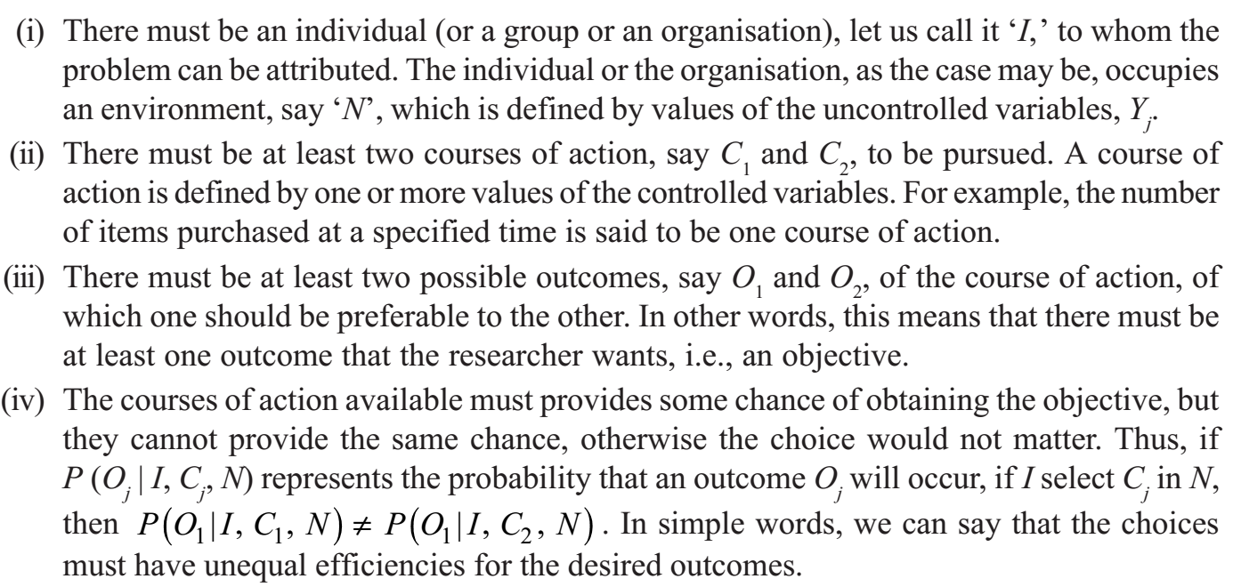
WHAT IS A RESEARCH PROBLEM?
A research problem does exist if the following conditions are met with:

Slide 12
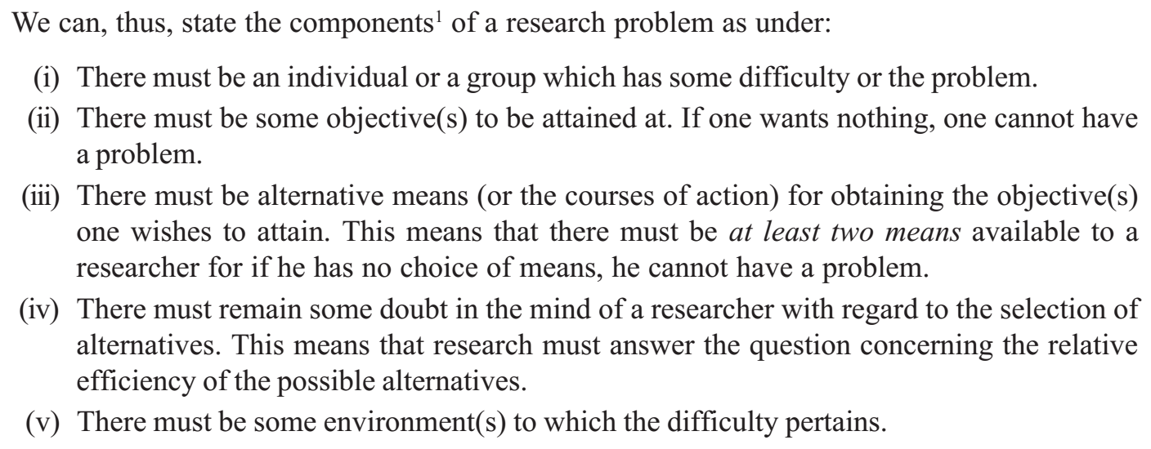
WHAT IS A RESEARCH PROBLEM?
Over and above these conditions, the individual or the organisation can be said to have the problem only if ‘I’ does not know what course of action is best, i.e., ‘I’, must be in doubt about the solution.

Slide 13
SELECTING THE PROBLEM
The research problem undertaken for study must be carefully selected.
The task is a difficult one, although it may not appear to be so.
Every researcher must find out his own salvation for research problems cannot be borrowed.
However, the following points may be observed by a researcher in selecting a research problem or a subject for research:

Slide 14
SELECTING THE PROBLEM
Subject which is overdone should not be normally chosen, for it will be a difficult task to throw any new light in such a case.
Controversial subject should not become the choice of an average researcher.
Too narrow or too vague problems should be avoided.
The selection of a problem must be preceded by a preliminary study.
Before the final selection of a problem is done, a researcher must ask himself the following questions:
(a) Whether he is well equipped in terms of his background to carry out the research?
(b) Whether the study falls within the budget he can afford?
(c) Whether the necessary cooperation can be obtained from those who must participate in research as subjects?

Slide 15
NECESSITY OF DEFINING THE PROBLEM
A problem clearly stated is considered “a problem half solved.”
Defining a research problem is essential for clarity and direction.
A well-defined problem helps distinguish relevant data from irrelevant data.
Proper definition keeps the researcher on track, while an ill-defined problem creates hurdles.
Key questions depend on problem definition:
What data should be collected?
Which characteristics of the data are relevant?
What relationships need to be explored?
What techniques should be applied?
Formulating the problem can be more critical than solving it.
Careful detailing of the research problem is the basis for designing the research and executing all subsequent steps smoothly.

Slide 16
TECHNIQUE INVOLVED IN DEFINING A PROBLEM
What does one mean when he/she wants to define a research problem?
The answer may be that one wants to state the problem along with the bounds within which it is to be studied.
In other words, defining a problem involves the task of laying down boundaries within which a researcher shall study the problem with a pre-determined objective in view

Slide 17
TECHNIQUE INVOLVED IN DEFINING A PROBLEM
The technique for the purpose involves the undertaking of the following steps generally one after the other:
(i) statement of the problem in a general way;
(ii) understanding the nature of the problem;
(iii) surveying the available literature
(iv) developing the ideas through discussions; and
(v) rephrasing the research problem into a working proposition.

Slide 18
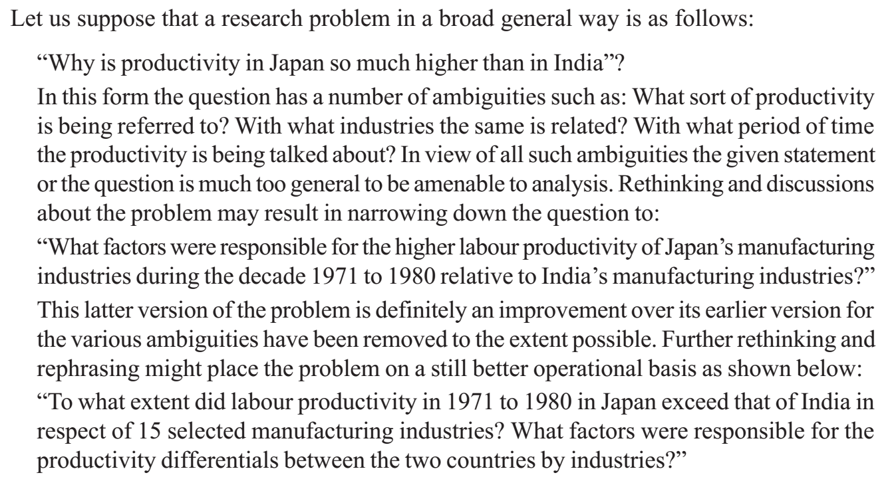
AN ILLUSTRATION - I

Slide 19
AN ILLUSTRATION - I
With this sort of formulation, the various terms involved such as ‘labour productivity’, ‘productivity differentials’, etc. must be explained clearly.
The researcher must also see that the necessary data are available.
In case the data for one or more industries selected are not available for the concerning time-period, then the said industry or industries will have to be substituted by other industry or industries.
The suitability of the time-period must also be examined.
Thus, all relevant factors must be considered by a researcher before finally defining a research problem.

Slide 20
AN ILLUSTRATION - II
Broad, general research problem
“Why is software development more efficient in Company Microsoft than in Company ABC?”
This is too vague and ambiguous:
What does “efficient” mean? Faster delivery? Fewer bugs? Lower costs?
Which types of software projects (web, mobile, embedded)?
What time period?
Which metrics are being used for comparison?

Slide 21
AN ILLUSTRATION - II
Narrowed-down version:
“What factors were responsible for the higher productivity of Company A’s agile development teams compared to Company B’s teams during the period 2015–2020?”
This removes many ambiguities:
Focuses on agile teams
Defines time period
Specifies productivity in software development

Slide 22
AN ILLUSTRATION - II
More precise, operational version:
“To what extent did agile software development teams in Company A between 2015 and 2020 outperform those in Company B in terms of (a) average release cycle time, (b) defect density, and (c) customer satisfaction? What factors accounted for these differences?”
Now, the research problem is:
Focused on specific performance metrics (release cycle time, defect density, satisfaction)
Limited to a timeframe
Clearly set for a comparative analysis

Slide 23
CONCLUSION
We may conclude by saying that the task of defining a research problem, very often, follows a sequential pattern—
the problem is stated in a general way,
the ambiguities are resolved,
thinking and rethinking process results in a more specific formulation of the problem so that
it may be a realistic one in terms of the available data and resources and is also
analytically meaningful.

